Slide 1

Oscilloscope

Slide 2
What is an oscilloscope?
electronic test equipment that allows observation of constantly varying voltages, as a two-dimensional graph of one or more voltages using the vertical or y‑axis and plotted as a function of time (horizontal or x‑axis).
used to observe the exact wave shape of an electrical signal to allow for the measurement of peak-to-peak voltage of a waveform, the frequency of periodic signals, the time between pulses, the time taken for a signal to rise to full amplitude (rise time), and relative timing of several related signals.

Slide 3
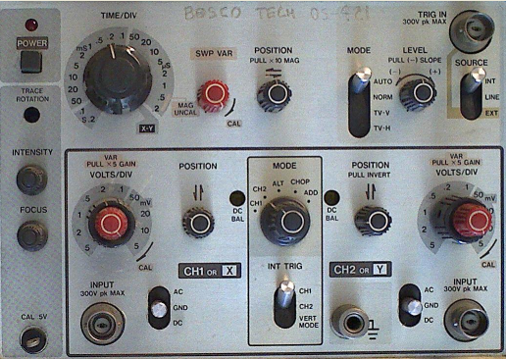
Controls

Slide 4
Control Descriptions
Power button: turns the device on/off
Focus knob: sharpens the image on screen
Intensity knob: brightens/dims the screen
Time/Div switch: calibrates the internal horizontal sweep to the external waveform for visual measurement.
Horizontal Positioning knob: positions the image horizontally.
Horizontal Trigger Mode switch: sets the triggering mode.

Slide 5
Control Descriptions
Horizontal Trigger Source switch: selects the trigger source.
Horizontal Trigger Level knob: selects when the trigger will occur when in trigger source is external.
Ch1 Input Port: input voltage connection for Ch1
Ch1 Volts/Div knob: calibrates the internal vertical sweep to the external waveform for visual measurement.
Vertical Positioning knob: positions the image vertically.

Slide 6
Control Descriptions
AC/DC coupling switch: selects AC or DC.
Mode knob: selects which channel will be displayed.
INT TRIG (Internal Trigger Source) switch : selects which channel will trigger the vertical sweep.

